Slide 1
Food Diary Manager
Favour, Vrishti, Saif

Slide 2
Introduction
Food Diary Manager
A nutrition management application designed to help consultants manage client diets and allow clients to track their food intake.
Problem we're solving:
Nutritionists/consultants need a way to manage client goals.
Clients need to record what they eat.
Clients need to search for food and access nutritional information.
The application brings these features together in one system.

Slide 3
Team & Project Features
Main features
Consultant
Manage clients
Set client goals
Update goals
Delete goals
Client
Record food intake
View food diary
Search for food
Search and adding using barcodes
View nutritional information
Authentication
Sign up
Sign in
JWT authentication

Slide 4
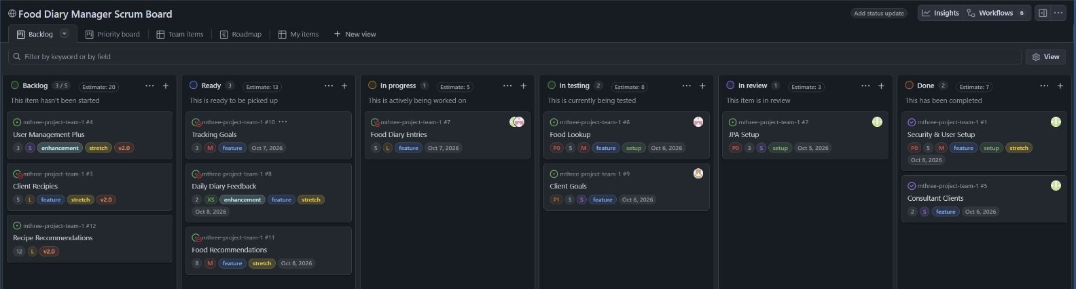
Responsibilities
Vrishti
User management, JWT-based security and frontend
Favour
Client goals
Saif
Food diary and API lookup

Slide 5
Technologies

Slide 6







Technologies
Backend Rest API
  Spring Framework & Spring Boot – core backend
    Spring Data JPA – data access and persistence management
    Spring Security – authentication & authorisation
    oauth2-resource-server – JWT validation
  jjwt – JWT generation
  MySQL database – data storage
  OpenFoodFactsAPI – 3rd party API
  JUnit & Mockito – testing and stubbing behaviour
  Postman – web layer tests
Frontend Demo
  React.js - frontend demo application
  Axios – XMLHttpRequest (XHR) wrapper for Ajax style requests
  Bootstrap – styled frontend components
  html5-qrcode.js – barcode scanner provision

Slide 7
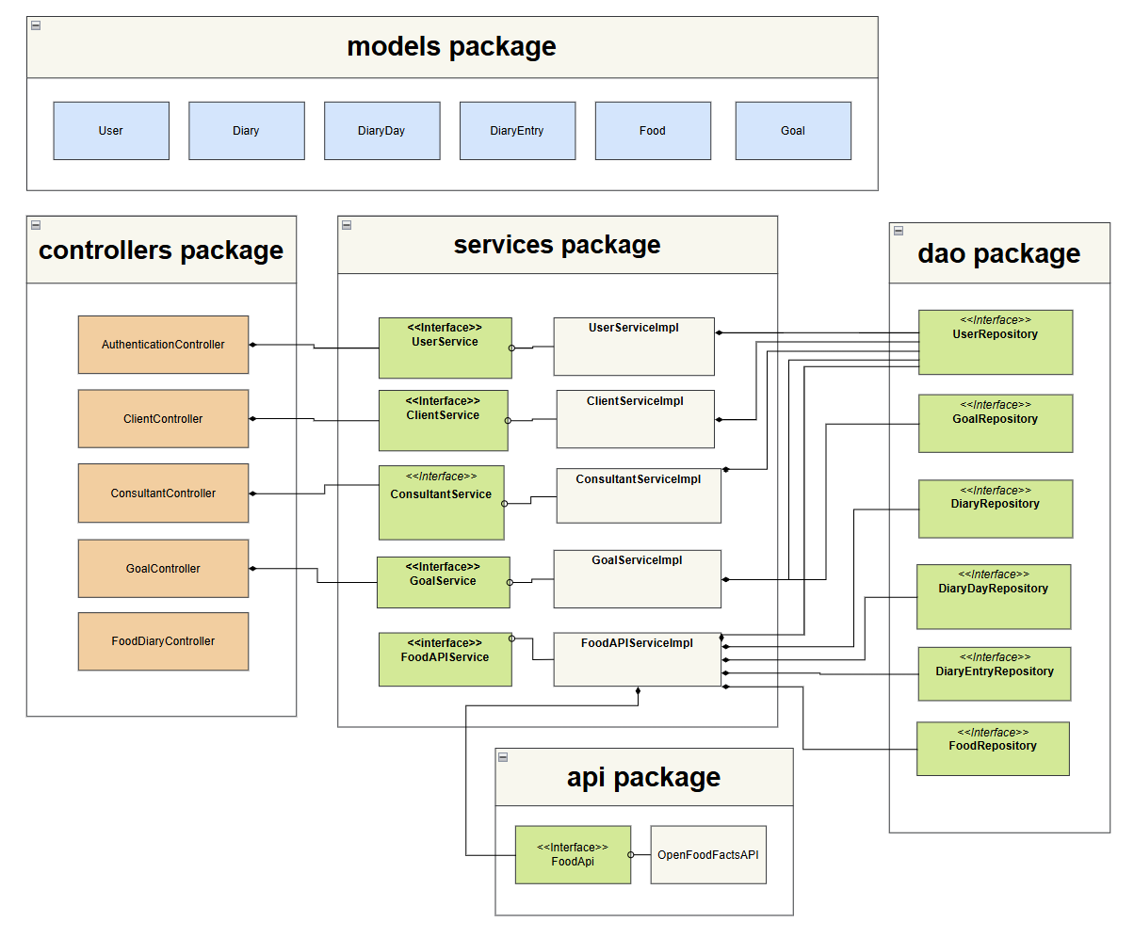
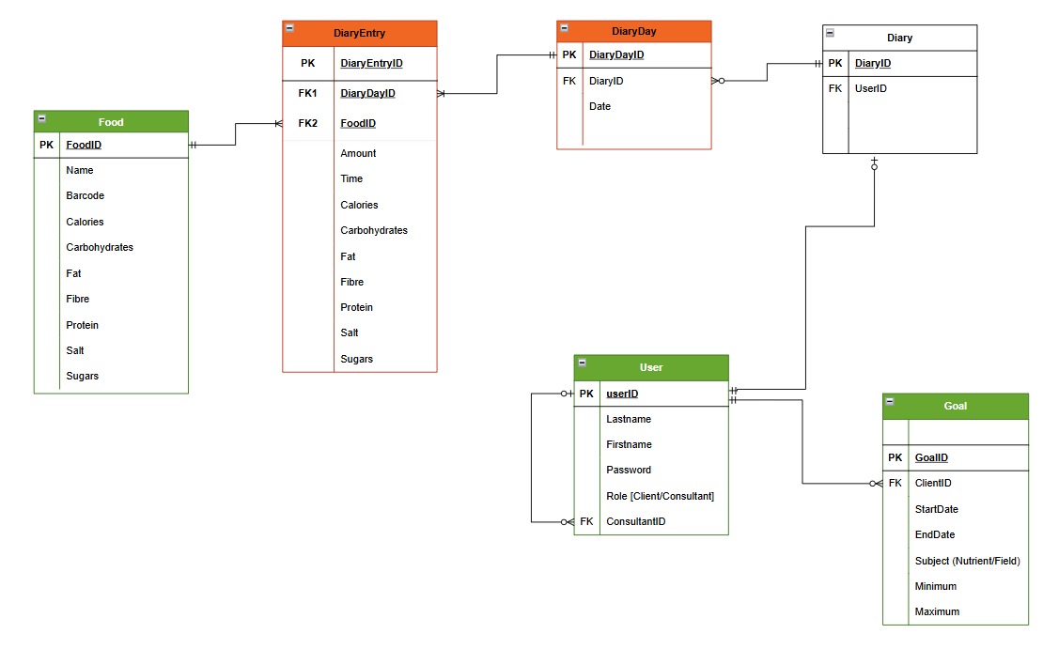
Application Architecture
Class Diagram & ERD
Simplified Views

Slide 8
Live Demo
Loading ...

Slide 9
The Future (V2.0)
UX improvements
A consultant can give daily feedback to their clients
A recipe lookup feature – A user can see recommended recipes based on their goals
The client can see the percentage of goals achieved

Slide 10
Lessons Learned
Deadlines – Underestimated how long each feature would take to implement.
  We adjusted our timeline to move the stretch to v2.0, allowing us to prioritise quality over quantity.
  Teamwork and helping each other out.
Working in parallel – Agreeing upon endpoints and parameters to send.

Slide 11
Q&A

